Slide 1
Cricbuzz Live Stats: Real-Time Cricket Insights & SQL-Based Analytics
Presented By:
Dev Prasath RP
DS-S-WD-T-B137

Slide 2
Introduction
A real-time cricket analytics dashboard that integrates Cricbuzz API with SQL database operations to provide live match insights, player analytics, and advanced SQL-based cricket analysis.
Technologies Used:
Python, SQL, Streamlit, REST API, Pandas, JSON

Slide 3
Objective of the Project
The goal of this project is to build an interactive cricket analytics platform that:
Fetches real-time cricket data using Cricbuzz API
Stores and manages data using a SQL database
Displays live scorecards and player statistics
Provides advanced cricket analytics using SQL queries
Supports CRUD operations for database management

Slide 4
System Architecture and Workflow
Step 1 — API Integration
Cricbuzz API used to fetch:
Live matches
Scorecards
Player statistics
Series details
Step 2 — Data Processing
Python and Pandas used for:
Cleaning data
Transforming JSON responses
Structuring cricket datasets
Step 3 — SQL Database
Store processed data in:
MySQL / PostgreSQL / SQLite
Step 4 — Streamlit Dashboard
Display:
Live scores
Player stats
SQL analytics
CRUD operations

Slide 5
Tech stack
Technology | Purpose
Python | Backend Development
Streamlit | Interactive Dashboard UI
SQL | Data storage and analytics
REST API | Fetch live cricket data
Pandas | Data Manipulation
Request Library | API Calls
JSON | API Response Handling
Git And Github | Version Control
Why These Technologies?
Streamlit provides fast UI development
SQL enables complex analytics
Python simplifies API integration and data processing

Slide 6




Project Workflow
Database

Slide 7
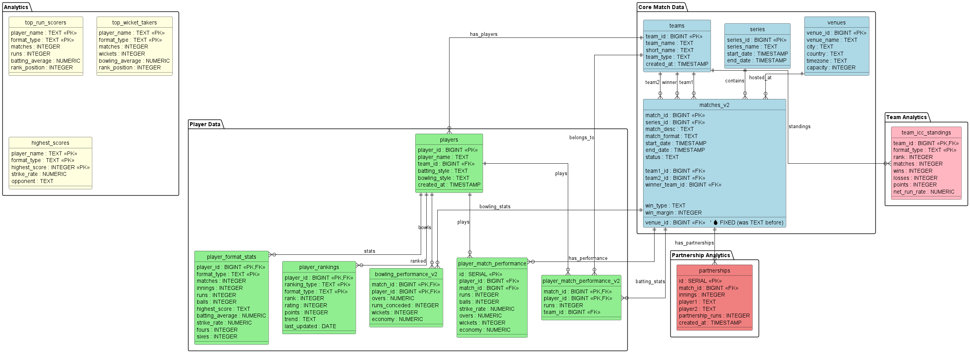
Database ER Diagram

Slide 8
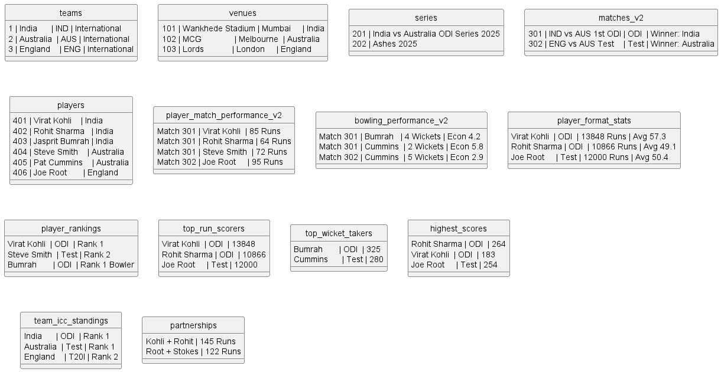
Database ER Diagram

Slide 9
Dashboard Features
1️⃣ Home Page
Project overview
Navigation system
Instructions
2️⃣ Live Match Page
Displays:
Live score
Match status
Batting & bowling stats
Venue details
3️⃣ Player Statistics Page
Shows:
Top batsmen
Top bowlers
Highest scores
Most wickets
4️⃣ SQL Analytics Page
25 advanced SQL queries
Real-time analytical outputs
Interactive tables
5️⃣ CRUD Operations Page
Add/Edit/Delete records
Database interaction using forms

Slide 10
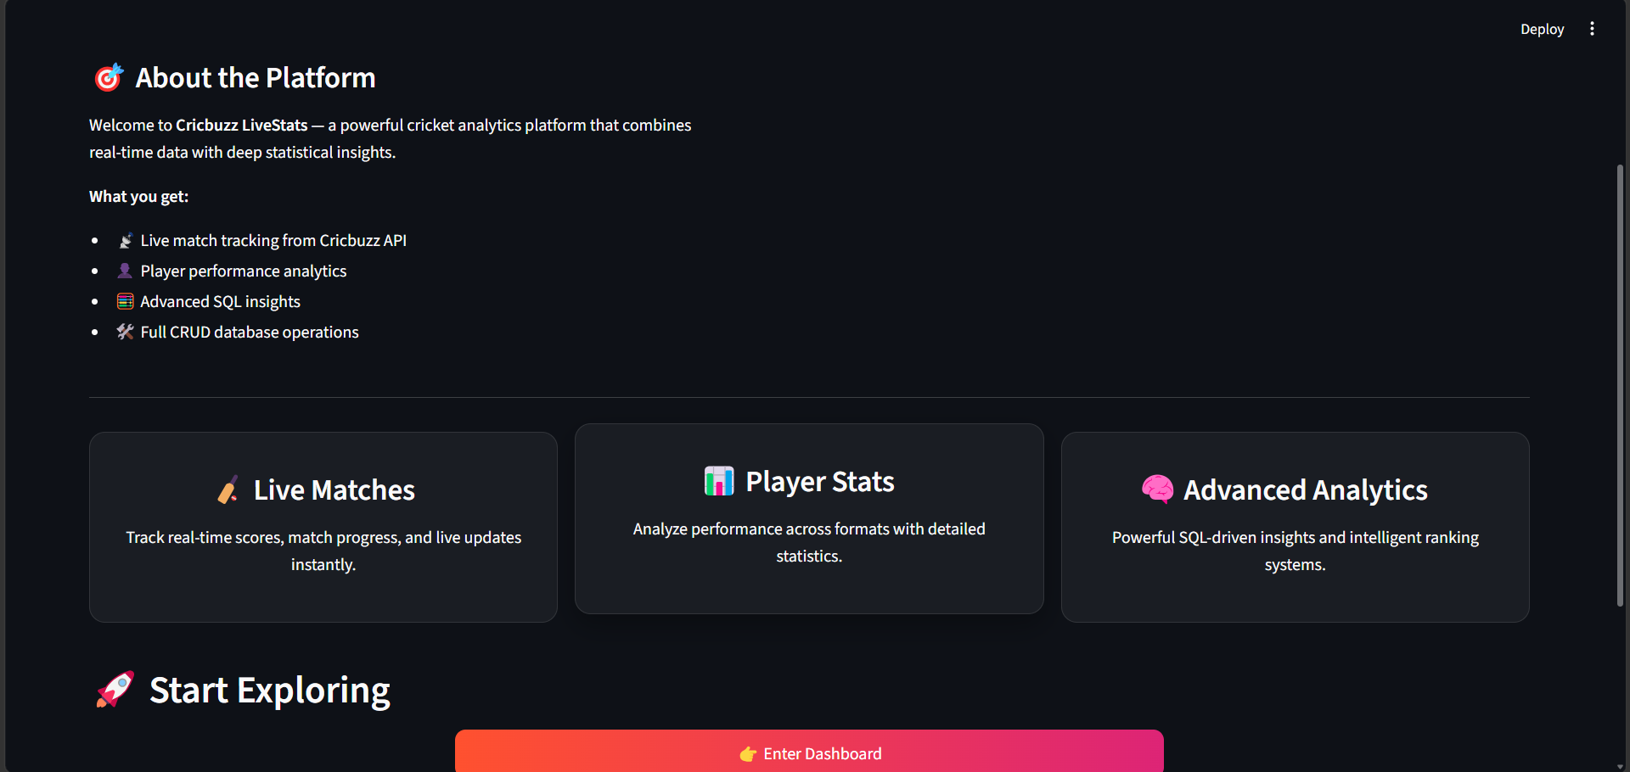
Home Page

Slide 11
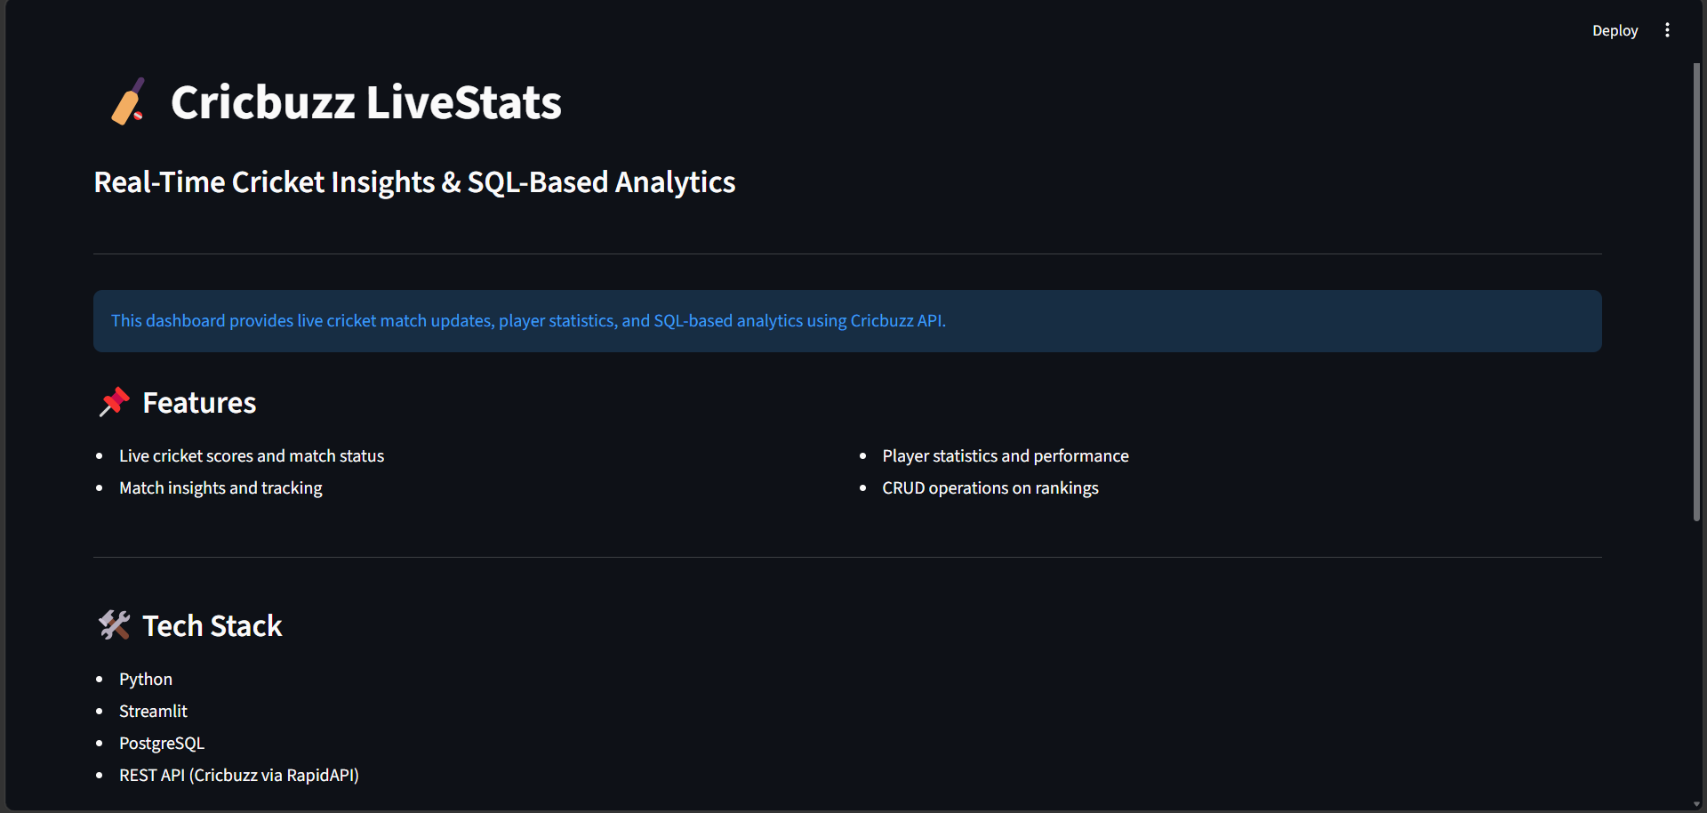

Slide 12
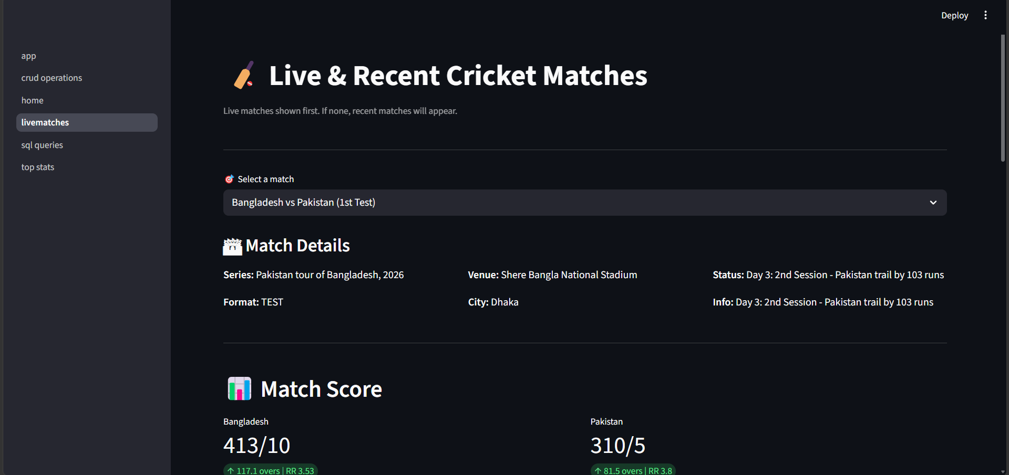
Live Matches Scorecard

Slide 13
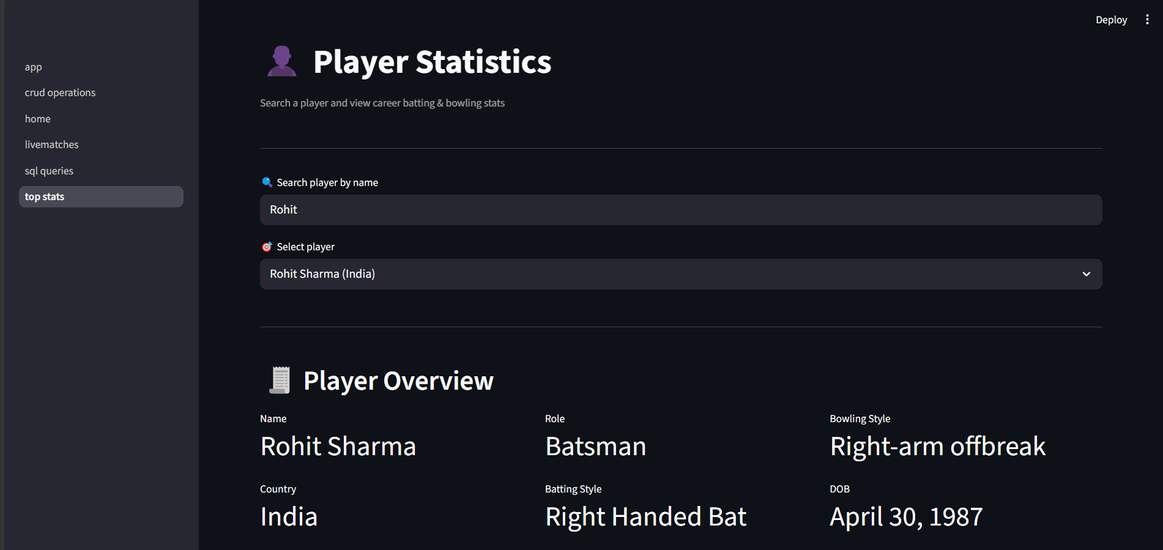
Player Stats Page

Slide 14
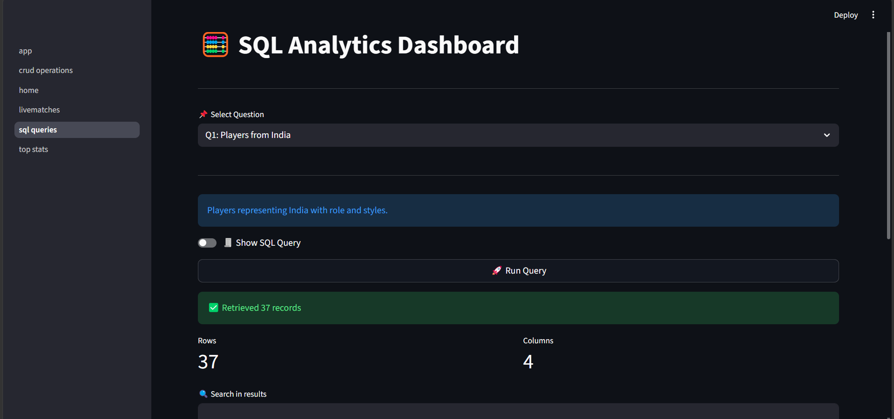
SQL Analytics Dashboard

Slide 15
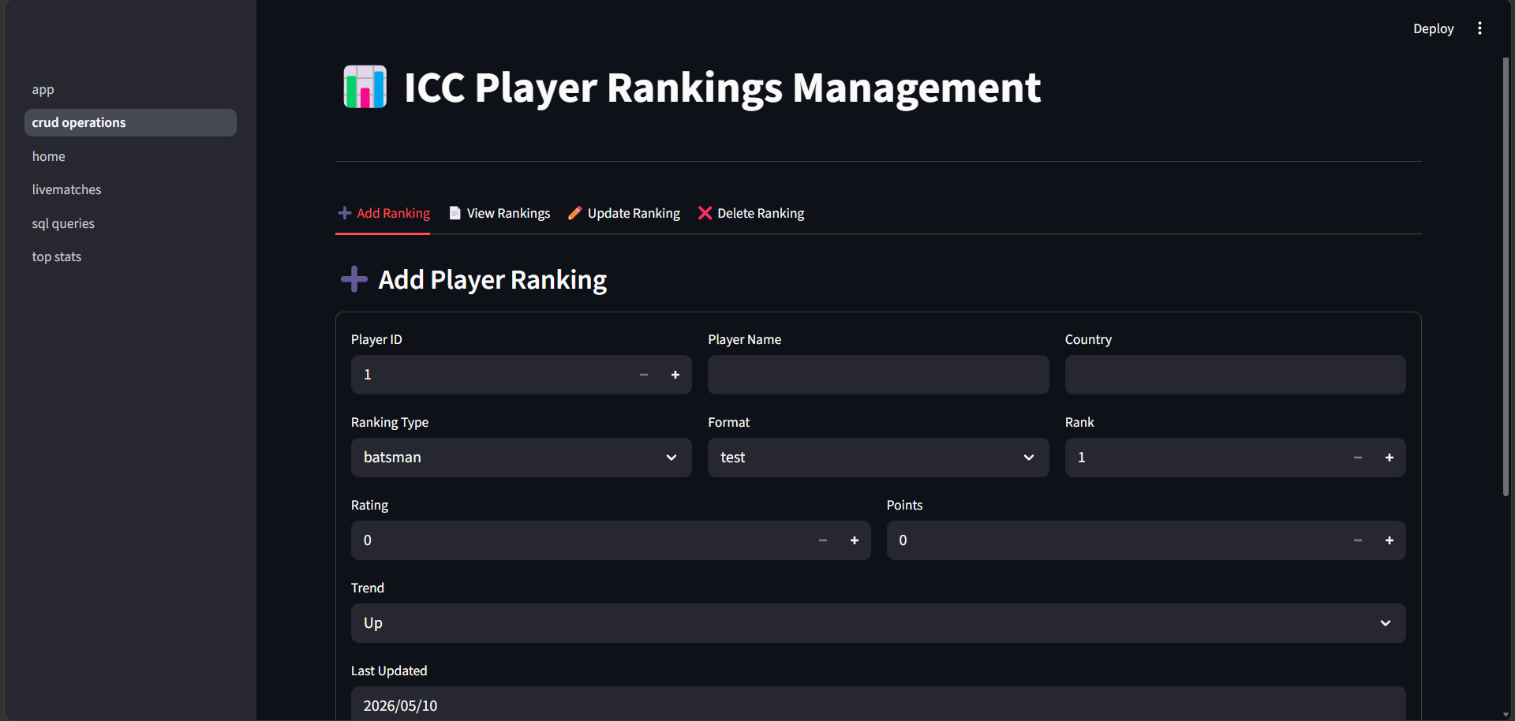
CRUD Operation Page

